Slide 1


Navigating
For Job Seekers (Module 3)
Searching for Jobs
Notes:
Hello, and welcome to navigating Work In Texas. In this module we will learn how to search for jobs using the system.
(Click to Reveal)

Slide 2
Getting started:
Notes:
At this point you have already created your WorkInTexas profile and created your resume. If you have not completed these steps, please refer to Modules 1 and 2 for help. Let us get started
(Click to Reveal)

Slide 3
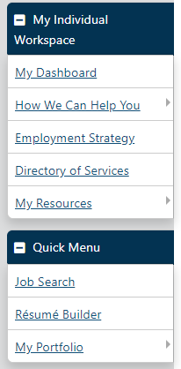
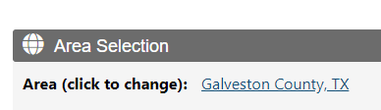
Getting Started
Search for Jobs
  Find job listings based on your employment history,
  desired occupation, associated job skills, and more.
  1. From the Quick Menu, click Job Search.
  To change the geographical search area from
  what was previously used, click the Area name to
  select a new search area.
Notes:
Assuming that you have logged into your workintexas account and are now looking at your desktop, Scroll down the left-hand menu bar until you see this section labeled quick menu. In this section you will find a link labeled Job Search. Click on this link and you will be taken to another page where you will see the beginning options for your search. Pay close attention to the Area Selection section to ensure you are looking in the right area. If you need to change this, just click on the underlined result and you can select new options there.
(Click to Reveal)

Slide 4
Getting Started
Search for Jobs
  3. Select one of the following search methods by clicking on the tab title:
    • Quick – Select any combination of criteria; search for a specific job order in the Job Order Number Search section.
    • Advanced – Select any combination of criteria. Search for State of Texas jobs from this tab by selecting State Government and State Universities as Employer Types in the Preferred Employers section.
    • Intelligent – Choose from three different pre-set job searches that use your profile information and jobs that other similar seekers have searched or applied for.
Notes:
Below the Area Selected, you will find a series of 7 tabs. The first tab is used to start a “quick” search from any combination of criteria or a specific job order number if you havfe received one from an employer, staff, or previous searches. The next tab is labeled Advanced and can be used to search for State of Texas jobs by selecting State Government and State Universities as Employer Types in the Preferred Employers section. Beside the advanced tab you will find the tab labeled Intelligent, Here you can choose from three different pre-set job searches that use your profile information and jobs that other similar seekers have searched or applied for.
(Click to Reveal)

Slide 5

Getting Started
Search for Jobs
  Select one of the following search methods by clicking on the tab title:
    • Employer – Select job sources and choose an employer search method.
    • Education – Select job sources and choose an educational program and level; good for recent grads with little to no relevant work experience.
Notes:
The next two tabs are the Employer and Education sections. In the employer tab you can select job sources and choose a specific employer to search. In the education tab you can select job sources and choose an educational program an level. This option is great for recent graduates with little to no relevant work experience.
(Click to Reveal)

Slide 6


Getting Started
Search for Jobs
  Select one of the following search methods by clicking on the tab title:
    • Skills – Select job sources, then choose a match ratio (70%, 50%, 25%) for desired skill sets from your self-assessments: job, tools and technology, workplace WorkKeys® (if applicable), personal, interests, and work values.
    • Résumé – Select one of your résumés to search for jobs that fit the skills and other criteria included in it.
  4. Click Search. A search results page will appear with any jobs matching your criteria.
Notes:
The last two sections you will find are the skills and resume section. In the skill selection you can select job searches then choose match ratio, which will match your desired skill sets and any self assessments to open positions. In the resume section you can search based off of the criteria from any resume that you have created in the system.
Once you have navigated the appropriate tab and filled in any information to narrow your search select the search button to view your results
. (Click to Reveal)

Slide 7

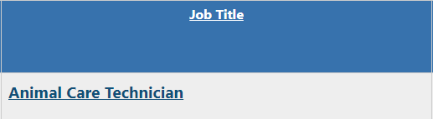

Getting Started
Search for Jobs
On a job search results page, you can:
  • Choose between the Summary or Detailed Results View.
  • View job details, and apply for the job, by clicking a job title link.
  • View skills/requirements matching by clicking the percentage icon in the General Requirements Match column.
  • View employer locations in Google Maps by clicking the Select checkbox for the desired job listing and then clicking the Map link at the bottom of the search results page.
Notes:
After you click the search button you'll be taken to the results page in the results page at the very top of your search results you'll see two options which are summary and detailed this chooses the view that you have whether you wanted compact or full details if you want to look at a particular job details find the job listing in your results and then click on the link with the job title. If your results have a varied amount a match percentages by clicking on the match percentage, you can see how the job request matches your resume . Here you may need to go back into your skills and tools area and reaffirm any skills or tools that you may have missed. And finally in the last column You will find checkboxes. Select any jobs that interest you and then Scroll down and you'll find a link for map. If you click on this link it will bring up a Google map of the locations for each job.
(Click to Reveal)

Slide 8

Getting Started
Search for Jobs
On a job search results page, you can:
  • Use the legend at the bottom of the search results page to see where the job listings came from.
  • Re-sort the job listings by clicking the desired column heading; clicking again reverses the sort order.
  • Reduce the number of listings by clicking the Hide potential duplicates checkbox.
Notes:
At the bottom of the search results below the total number of records found, you'll find a horizontal list of all the different sources the jobs were retrieved. Also, if you want to sort your results by any of these column headings, click on the job heading to sort. Clicking a second time on the same column heading will reverse the sort results. If you happen to notice job results from different sources but are still the same job, you can click in the hide potential duplicates box to consolidate those results.
(Click to Reveal)

Slide 9
Getting Started
Search for Jobs
On a job search results page, you can:
  • Change how many listings are displayed per page by selecting the desired number of rows at the bottom of the search results page.
  • Navigate multiple pages by clicking the arrows to navigate one page at a time or select a desired page number at the bottom of the search results page.
Notes:
If your job results listing is too long or too short, you can click on the down arrow next to rose and choose how many results you want to see per page. Use the arrows in the page section to navigate from page to page. If you know a certain page that you want to go to, click the down arrow next to the page number and select the page you wish to visit.
(Click to Reveal)

Slide 10
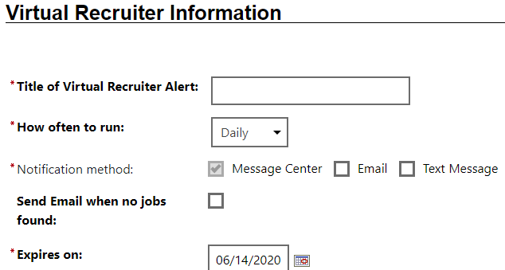
Getting Started
Create a Virtual Recruiter Job Search Alert
After conducting a job search, at the bottom of the search results page, click the Save Search button.
  Enter a title for this Virtual Recruiter
  Alert.
  Specify How often to run the search.
  Specify if you wish to be notified via
  email (in addition to the WorkinTexas.com
  Message Center).
  Specify if you wish to receive “no jobs found”
  notification emails.
  Enter an expiration date (defaults to 30 days).
  Click Save.
Notes:
Once you have the search results you are looking for from the criteria you selected, you can save your search at the bottom of the page. Here you will be given an option to create a virtual recruiting alert and be notified regularly of the results from your search. If you wish to use this option first enter a title for the virtual recruiting alert, then how often you want to run the alert. You will automatically get an alert through your workintexas message center, but you can also select to receive the results via email or through text message. If your search does not have any results you will not be notified unless you click the box that says send email when no jobs found. And finally how long do you want to run the search? Select a date you wish to stop receiving results from the virtual recruiting platform. The default is automatically set 30 days into the future but can be adjusted to meet your needs. Once you have done this just click save.
(Click to Reveal)

Slide 11
Getting Started
Apply for a Job
From the job search results page, click the desired job title link.
Review the job order details.
Click the How to apply button.
  a. For external jobs (job postings imported from third-party internet job boards, like Monster.com), a new browser window opens; follow the website instructions.
  b. For internal jobs that are not state jobs (job postings created within WorkinTexas.com), you must submit your application as specified by the job order. Application methods may vary from “submit a résumé” to “apply via website.”
  c. For state jobs, you must submit a State of Texas Application.
Notes:
Now that you have your job search done it's time to apply for a job. From the job search results page click the desired job title. Here you can review the job order details and click on the how to apply button to apply. Once you click on the how to apply button, if it is an external job posting likemonster.com or indeed, a new browser window will open and just follow the website instructions to apply. For jobs within the workintexas system that are not state jobs you must submit your application as specified by the job order. These methods may include but are not limited to submitting a resume directly or apply via the employer website. If you're applying for a state job, ensure you have created the state of Texas application in workintexas and then apply .
(Click to Reveal)

Slide 12
Conclusion
Notes:
We hope this module was helpful in getting you registered with the workintexas system. Thank you and be sure to check out the other modules in this series.
(Click to End)

